Slide 1
Machine Learning **** CLZG565
Support Vector Machine
Raja vadhana P
Assistant Professor,
BITS - CSIS

Slide 2
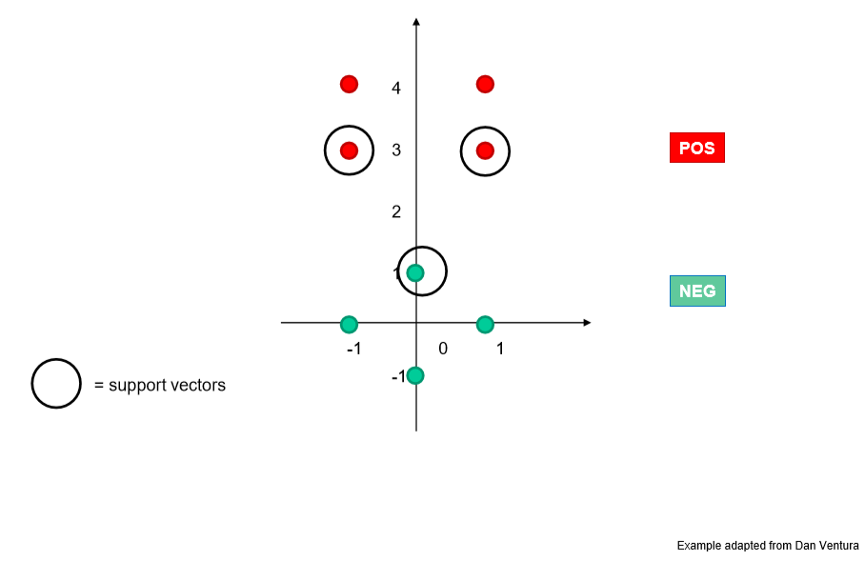
Problem Type – 1 Linear SVM
x₂
x₃
x₁

Slide 3
Problem Type – 1 Linear SVM
Solving for α
We know that for the support vectors, f(x) = 1 or -1 exactly
Add a 1 in the feature representation for the bias
The support vectors have coordinates and labels:
x₁ = [0 1 1], y₁ = -1
x₂ = [-1 3 1], y₂ = +1
x₃ = [1 3 1], y₃ = +1
Thus we can form the following system of linear equations:

Slide 4
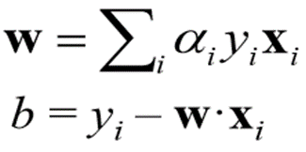
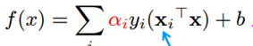
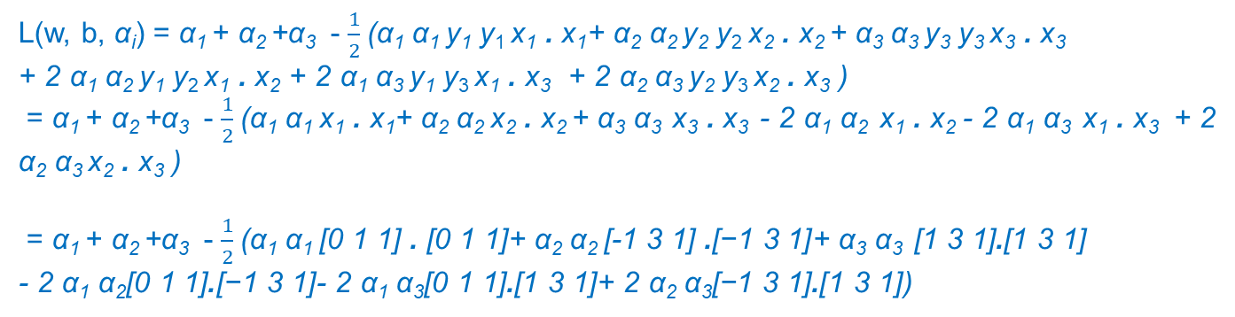
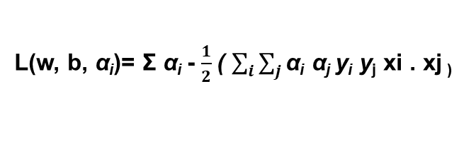
Linear SVM Problem
I Select the support vectors:
II Substitute in Lagrangian function:
III Find the Unconstrained Optimization Function:
α_{i} [-1 (w . x_{i} + b)] = -1
α_{i} [+1 (w . x_{i} + b)] = 1
x₁ = [0 1 1], y₁ = -1
x₂ = [-1 3 1], y₂ = +1
x₃ = [1 3 1], y₃ = +1
L(w, b, α_{i})= Σ α_{i} - $\frac{1}{2}$( $\sum_{i}{\sum_{j}{\text{α}\text{i} \text{α}\text{j} \text{y}\text{i} \text{y}\text{j} \text{xi}\text{ . }\text{xj}\text{ ) }}}$
L(w, b, α_{i}) = α₁ + α₂ +α₃ - $\frac{1}{2}$($\text{α}\text{1} \text{α}\text{1} \text{y}\text{1} \text{y}\text{1} \text{x}\text{1} \text{.} \text{x}\text{1}$+ $\text{α}\text{2} \text{α}\text{2} \text{y}\text{2} \text{y}\text{2} \text{x}\text{2} \text{.} \text{x}\text{2 }$+ $\text{α}\text{3} \text{α}\text{3} \text{y}\text{3} \text{y}\text{3} \text{x}\text{3} \text{.} \text{x}\text{3}$
+ 2 $\text{α}\text{1} \text{α}\text{2} \text{y}\text{1} \text{y}\text{2} \text{x}\text{1} \text{.} \text{x}\text{2}$ + 2 $\text{α}\text{1} \text{α}\text{3} \text{y}\text{1} \text{y}\text{3} \text{x}\text{1} \text{.} \text{x}\text{3}$ + 2 $\text{α}\text{2} \text{α}\text{3} \text{y}\text{2} \text{y}\text{3} \text{x}\text{2} \text{.} \text{x}\text{3}$ )
= α₁ + α₂ +α₃ - $\frac{1}{2}$($\text{α}\text{1} \text{α}\text{1} \text{x}\text{1} \text{.} \text{x}\text{1}$+ $\text{α}\text{2} \text{α}\text{2} \text{x}\text{2} \text{.} \text{x}\text{2 }$+ $\text{α}\text{3} \text{α}\text{3} \text{x}\text{3} \text{.} \text{x}\text{3}$- 2 $\text{α}\text{1} \text{α}\text{2} \text{x}\text{1} \text{.} \text{x}\text{2}$ - 2 $\text{α}\text{1} \text{α}\text{3} \text{x}\text{1} \text{.} \text{x}\text{3}$ + 2 $\text{α}\text{2} \text{α}\text{3} \text{x}\text{2} \text{.} \text{x}\text{3}$ )
= α₁ + α₂ +α₃ - $\frac{1}{2}$($\text{α}\text{1} \text{α}\text{1} \text{[0 1 1]} \text{.} \text{[0 1 1]}$+ $\text{α}\text{2} \text{α}\text{2} \text{[−1 3 1]} \text{.}\text{[−1 3 1]}$+ $\text{α}\text{3} \text{α}\text{3} \text{[1 3 1]}\text{.}\text{[1 3 1]}$
- 2 $\text{α}\text{1} \text{α}\text{2}\text{[0 1 1]}\text{.}\text{[−1 3 1]}$- 2 $\text{α}\text{1} \text{α}\text{3}\text{[0 1 1]}\text{.}\text{[1 3 1]}$+ 2 $\text{α}\text{2} \text{α}\text{3}\text{[−1 3 1]}\text{.}\text{[1 3 1]}$)
L(w, b, α_{i}) = α₁ + α₂ +α₃ - $\frac{1}{2}$($2\text{α}\text{1} \text{α}\text{1}$+ 11 $\text{α}\text{2} \text{α}\text{2}$+ 11 $\text{α}\text{3} \text{α}\text{3}$- 8 $\text{α}\text{1} \text{α}\text{2}$ - 8 $\text{α}\text{1} \text{α}\text{3}$+ 18 $\text{α}\text{2} \text{α}\text{3}$)

Slide 5
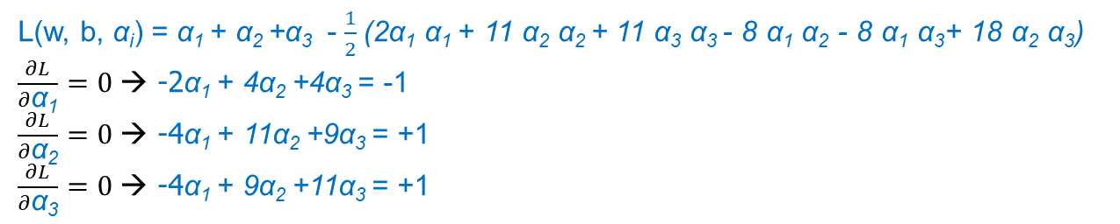
Linear SVM Problem
IV Gradient of the Lagrangian:
V Solve the simultaneous linear equation and find the lagrange multiplier:
α_{i} [-1 (w . x_{i} + b)] = -1
α_{i} [+1 (w . x_{i} + b)] = 1
L(w, b, α_{i}) = α₁ + α₂ +α₃ - $\frac{1}{2}$(2$\text{α}\text{1} \text{α}\text{1}$+ 11 $\text{α}\text{2} \text{α}\text{2}$+ 11 $\text{α}\text{3} \text{α}\text{3}$- 8 $\text{α}\text{1} \text{α}\text{2}$ - 8 $\text{α}\text{1} \text{α}\text{3}$+ 18 $\text{α}\text{2} \text{α}\text{3}$)
$\frac{∂L}{∂\text{α}\text{1}}=0$→ -2α₁ + 4α₂ +4α₃ = -1
$\frac{∂L}{∂\text{α}\text{2}}=0$→ -4α₁ + 11α₂ +9α₃ = +1
$\frac{∂L}{∂\text{α}\text{3}}=0$→ -4α₁ + 9α₂ +11α₃ = +1
( α₁ , α₂ , α₃ ) = (3.5, 0.75, 0.75)

Slide 6
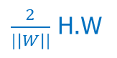
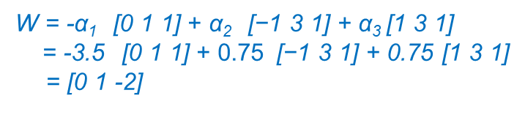
Linear SVM Problem
VI Substitute the Lagrange multiplier and obtain the weight’s:
VII Find the bias with help of any one of the support vectors:
VIII Construct the equation of the LSVM hyperplane:
IX Optionally find the width of the margin:
α_{i} [-1 (w . x_{i} + b)] = -1
α_{i} [+1 (w . x_{i} + b)] = 1
W = -α₁ $\text{[0 1 1]}$ + α₂ $\text{[−1 3 1]}$ + α₃ $\text{[1 3 1]}$
= -3.5 $\text{[0 1 1]}$ + 0.75 $\text{[−1 3 1]}$ + 0.75 $\text{[1 3 1]}$
= $\text{[}\text{0} \text{1} \text{−2}\text{]}$
Note the Bias is found above as a part of weight vector!!
W X+ b = 0
Y-2 = 0
Y=2
$\frac{2}{|\left|W\right||}$ H.W

Slide 7
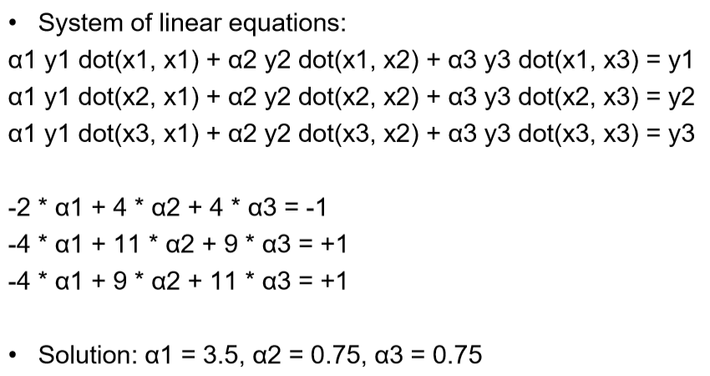
Problem Type – 1 Linear SVM Solving for α
α_{i} [-1 (w . x_{i} + b)] = -1
α_{i} [+1 (w . x_{i} + b)] = 1
α_{i} [-1 (w . x_{i} + b)] = -1
α_{i} [+1 (w . x_{i} + b)] = 1

Slide 8
Solving for w, b; plotting boundary
We know w = Σ α_{i} y_{i} x_{i} i.e w = α₁ y₁ x₁ + … + α_{N} y_{N} x_{N}
where N = No of SVs
Thus w = -3.5 * [0 1 1] + 0.75 [-1 3 1] + 0.75 [1 3 1] = [0 1 -2]
Separating out weights and bias, we have: w = [0 1] and b = -2
a=0, c=1
Boundary:
For SVMs, we used this eq for a line: ax + cy + b = 0 where w = [a c]
Thus ax + b = -cy ➔ y = (-a/c) x + (-b/c)
Thus y-intercept is (-b/c) = -(-2)/1 = 2
The decision boundary is perpendicular to w and it has slope
=(-a/c) = -0/1 = 0

Slide 9
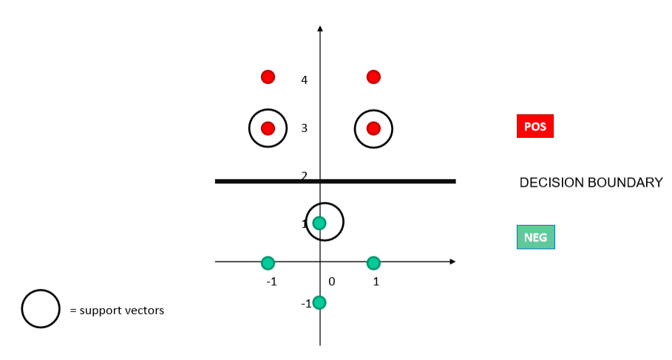
Problem Type – 1 Linear SVM Decision boundary

Slide 10
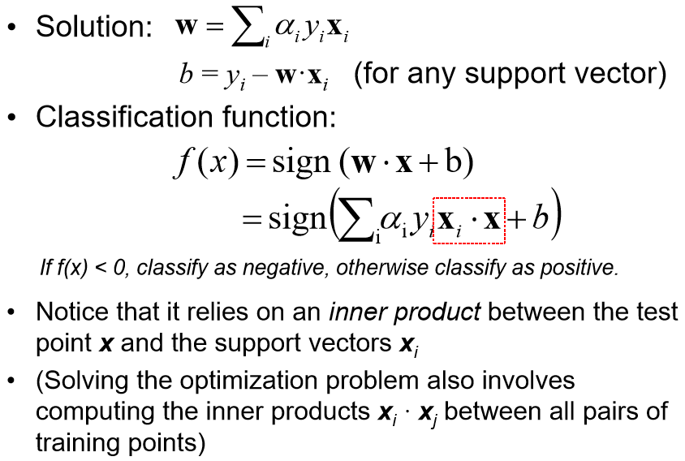
Linear SVM Problem
X Predict the class for unknown data:
α_{i} [-1 (w . x_{i} + b)] = -1
α_{i} [+1 (w . x_{i} + b)] = 1

Slide 11
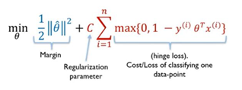
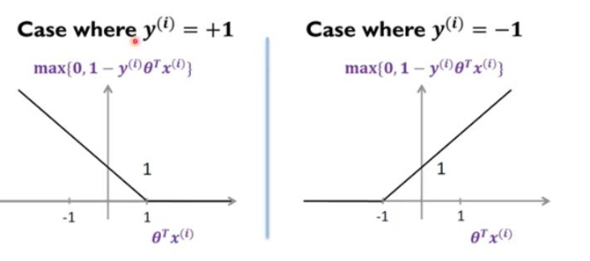
Slack variable-Hinge loss

Slide 12
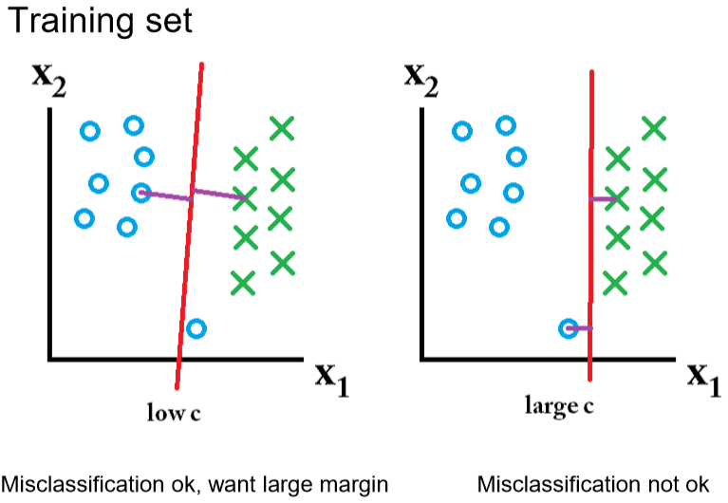
Soft Margin
Noisy Training Set
Solution :
Slack variables ξ
Regularization C
When C is large, larger slacks penalize the objective function of SVM’s more than when C is small
For Large values of C, the optimization will choose a smaller-margin hyperplane

Slide 13
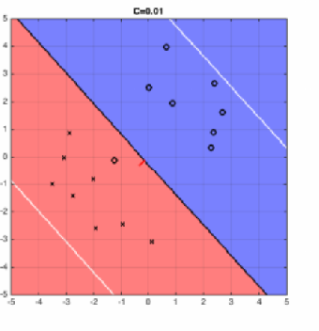
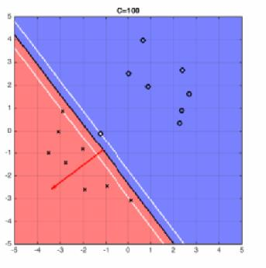
Effect of Margin size v/s misclassification cost
Effect of C
Small value of C will cause the optimizer to look for a larger-margin (small penalties) separating hyperplane, even if that hyperplane misclassifies more points.
For large values of C, the optimization will choose a smaller-margin (large penalties) hyperplane if that hyperplane does a better job of getting all the training points classified correctly.
C=infinity ->hard margin SVM

Slide 14
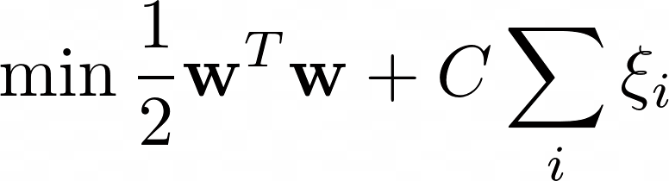
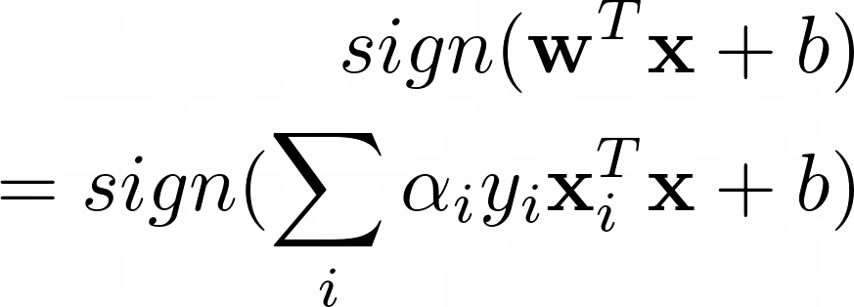
SVM Problem - Summary
SVM: Optimization
C parameter tells the SVM optimization how much you want to avoid misclassifying each training example and C can be viewed as a way to control overfitting
SVM: Training
Input: (X,y), C
Output: alpha for support vectors, b
Hyper parameter : C
SVM: Classification

Slide 15
Nonlinear SVM - kernels

Slide 16
Mapping into a New Feature Space
Rather than run SVM on x_{i}, run it on Φ(x_{i})
Find non-linear separator in input space
What if Φ(x_{i}) is really big?
Use kernels to compute it implicitly!

Slide 17

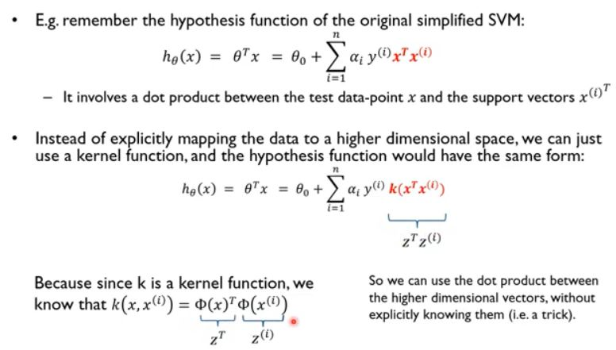
Kernel Trick (SVM)
BITS Pilani, Pilani Campus

Slide 18
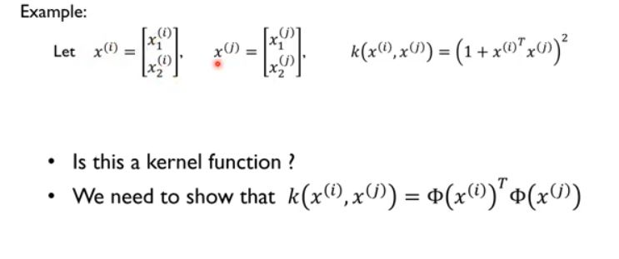
Problem Type - 2
BITS Pilani, Pilani Campus

Slide 19
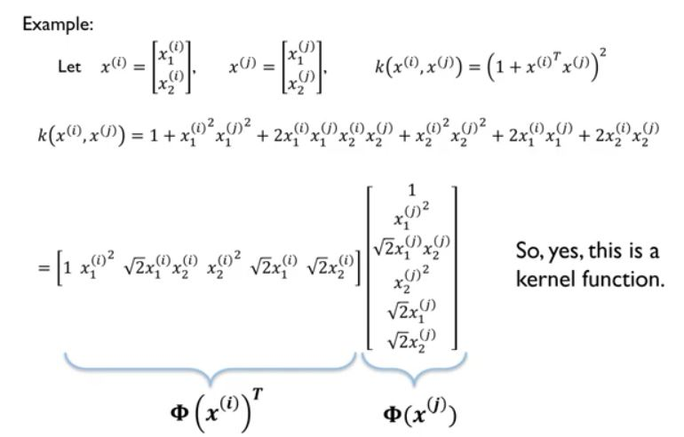
Problem Type - 2
BITS Pilani, Pilani Campus

Slide 20
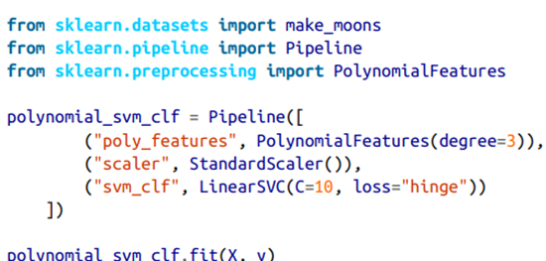
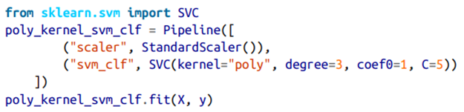
The hyper parameter coef0 controls how much the model is influenced by the polynomial
Notes:
https://www.geogebra.org/calculator

Slide 21
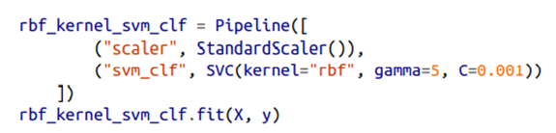
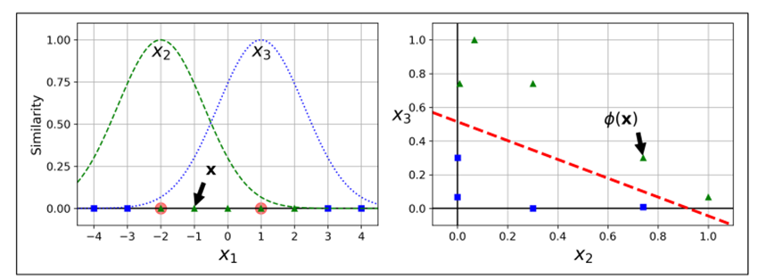
Non-Linear SVM- Idea
Increasing gamma makes the bell-shape curve narrower, and as a result each instance’s range of influence is smaller: the decision boundary ends up being more irregular
Notes:
https://www.geogebra.org/calculator

Slide 22
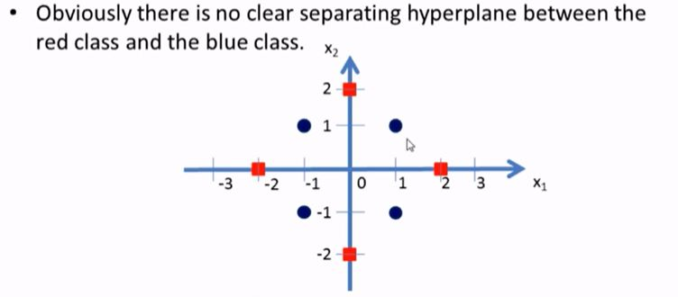
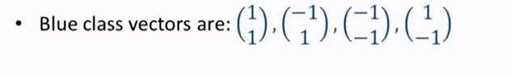
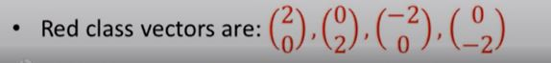
Problem Type - 3
BITS Pilani, Pilani Campus

Slide 23
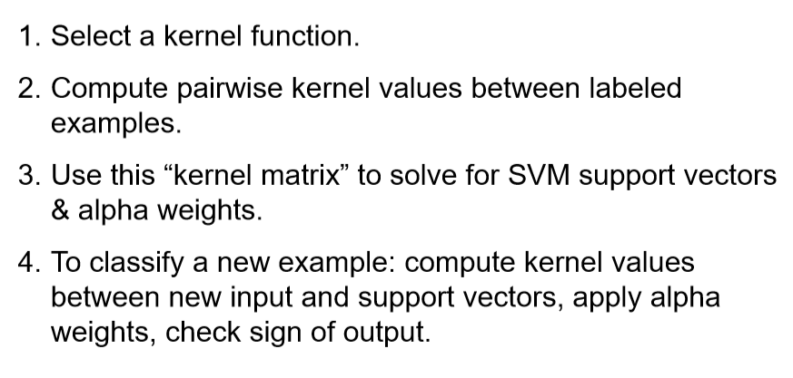
Non-linear SVM using kernel steps

Slide 24
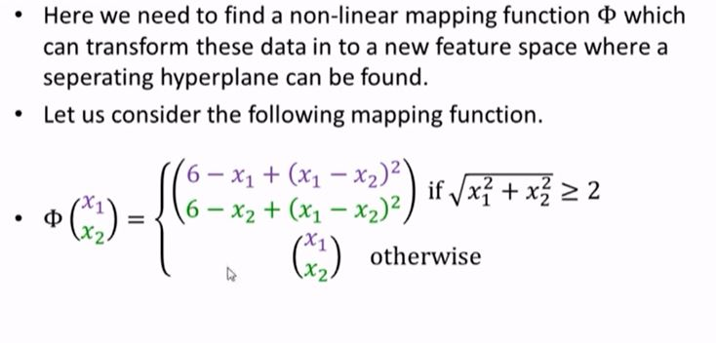
Problem Type - 3
BITS Pilani, Pilani Campus

Slide 25
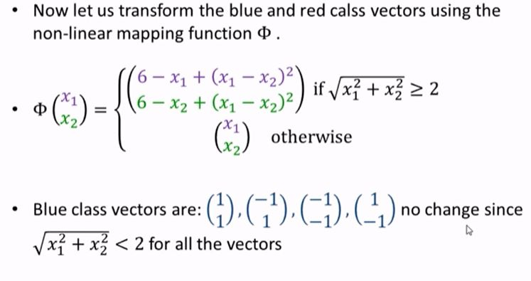
Problem Type - 3
BITS Pilani, Pilani Campus

Slide 26
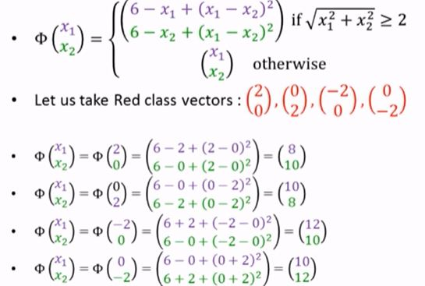
Problem Type - 3
BITS Pilani, Pilani Campus

Slide 27
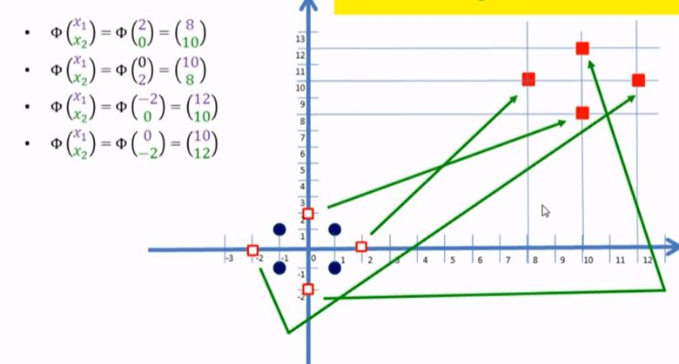
Problem Type - 3
BITS Pilani, Pilani Campus

Slide 28
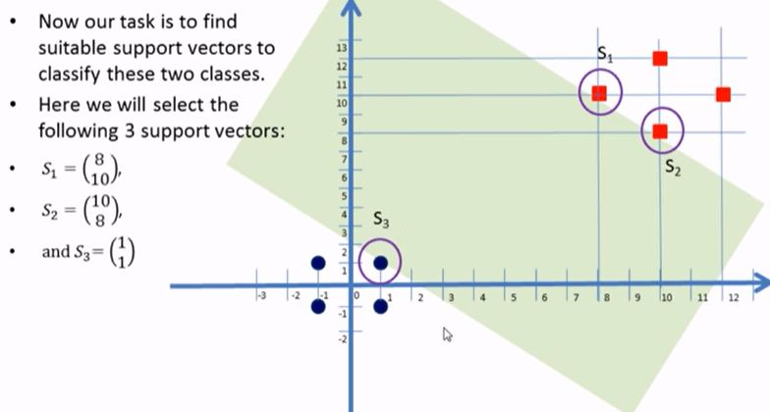
Problem Type - 3
BITS Pilani, Pilani Campus

Slide 29
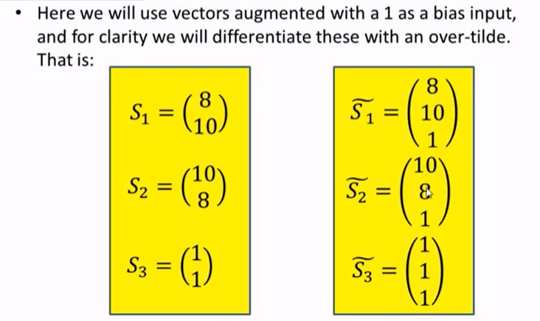
Problem Type - 3
BITS Pilani, Pilani Campus

Slide 30
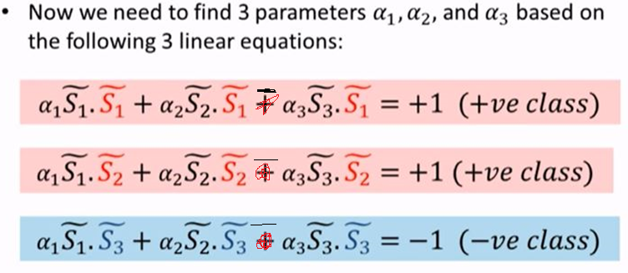
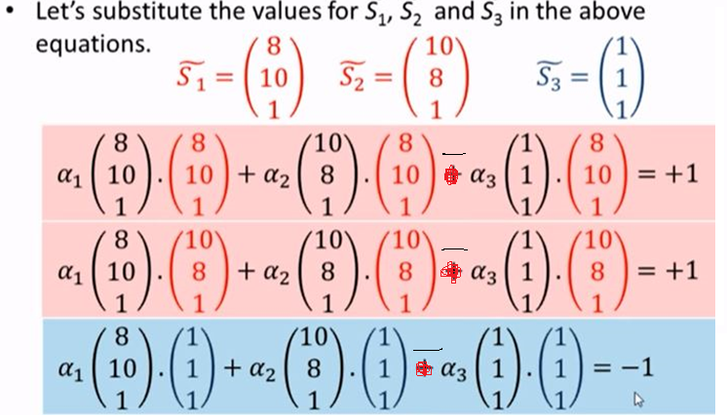
Problem Type - 3
BITS Pilani, Pilani Campus

Slide 31
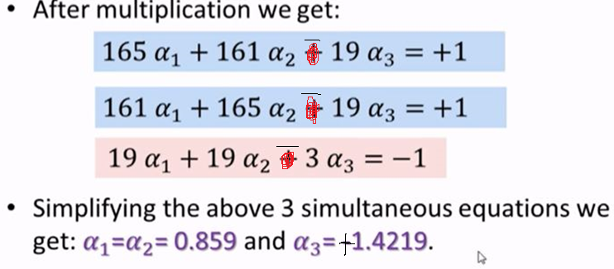
Problem Type - 3
BITS Pilani, Pilani Campus

Slide 32
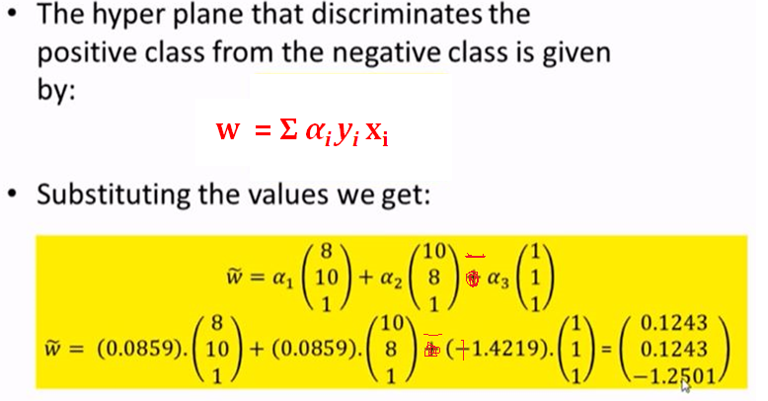
Problem Type - 3
BITS Pilani, Pilani Campus

Slide 33
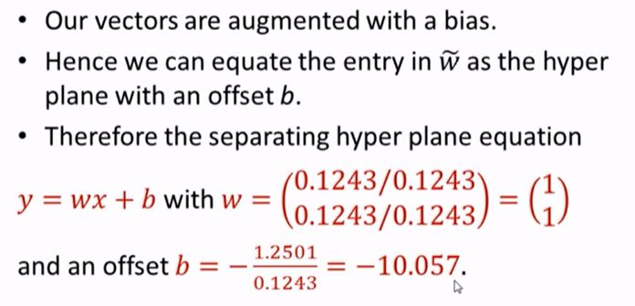
Problem Type - 3
For SVMs, we used this eq for a line: ax + cy + b = 0 where w = [a c]
Thus ax + b = -cy ➔ y = (-a/c) x + (-b/c)
Thus y-intercept is (-b/c)
The decision boundary is perpendicular to w and it has slope =(-a/c)
Y intercept
BITS Pilani, Pilani Campus

Slide 34
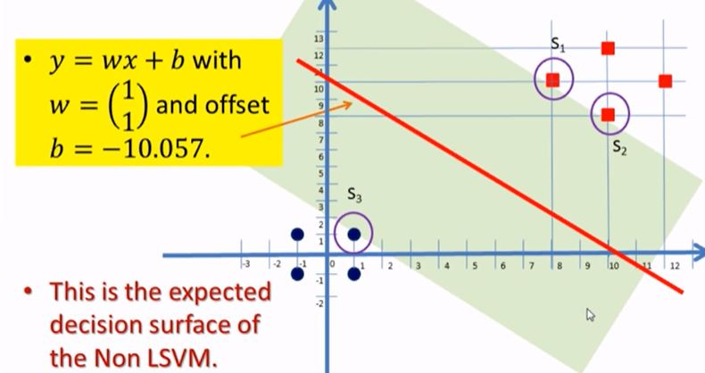
Problem Type - 3
BITS Pilani, Pilani Campus

Slide 35
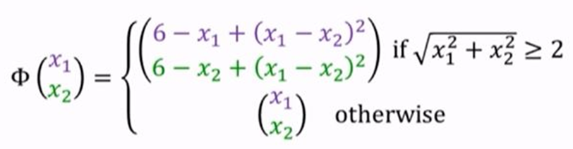
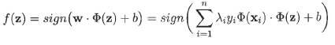
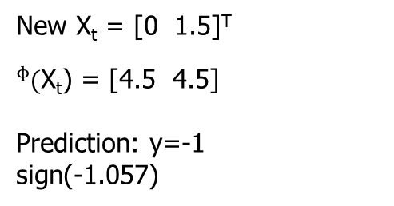
Problem Type - 3
New X_{t} = [0 1.5]^{T}
$ᶲ(\text{X}\text{t}$) = [4.5 4.5]
Prediction: y=-1
sign(-1.057)
SVM: Classification
BITS Pilani, Pilani Campus

Slide 36
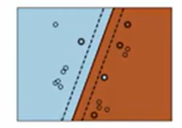
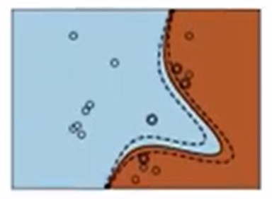
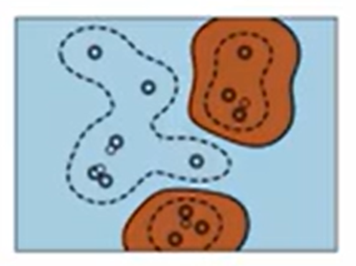
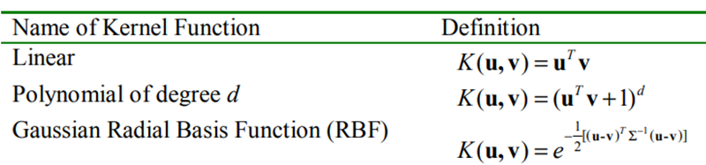
SVM Kernels
Linear Kernal Large Data Text
Polynomial Kernal Normalized Data Image Processing
Gaussian Kernal EDA not clear Computing Power

Slide 37
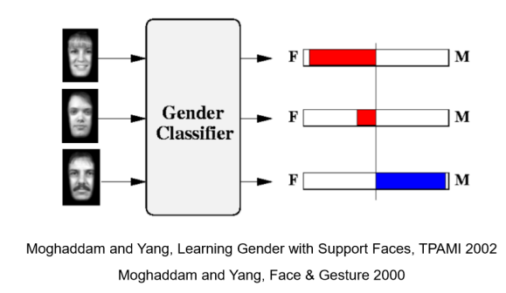
SVM Application – Observations
Learning Gender from Images

Slide 38
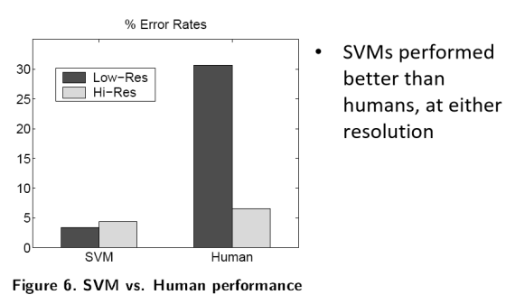
SVM Application – Observations
Image Analysis

Slide 39
Properties of SVM
Flexibility in choosing a similarity function
Sparseness of solution when dealing with large data sets
Only support vectors are used to specify the separating hyperplane
Therefore SVM also called sparse kernel machine.
Ability to handle large feature spaces
complexity does not depend on the dimensionality of the feature space
Overfitting can be controlled by soft margin approach
Nice math property: a simple convex optimization problem which is guaranteed to converge to a single global solution

